Slide 1
e-Health Ontario: A Medication Management System (MMS) for Ontarians
Presenter: Nick Khanna

Slide 2
Outline
Who is eHealth Ontario?
What they do?
Current Initiatives
Medication Management System (MMS)
Case
Other Functionalities within the MMS
Benefits:
Patients
Pharmacists
Future Outlooks

Slide 3
Who has heard of eHealth Ontario?
Questions
Positive, Negative, Both

Slide 4
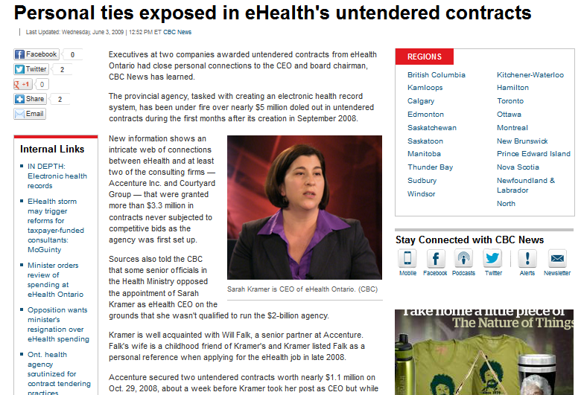
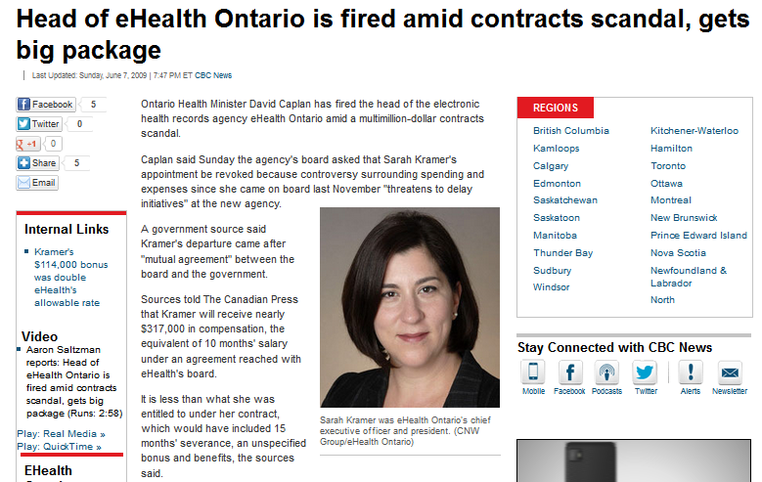
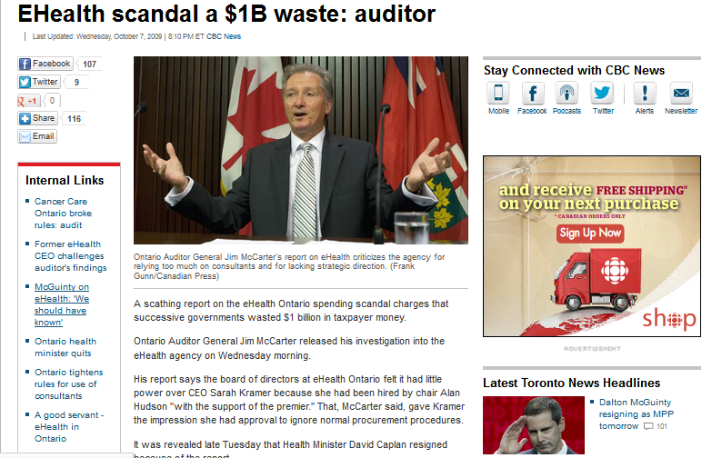
The Negatives

Slide 5
The Positives

Slide 6
e-Health Ontario
It is an independent agency of the Ministry of Health and Long-Term Care (MOHLTC) established by the provincial government in 2008
Notes:
funded by the Ministry of Health and Long-Term Care who are working towards enabling physicians and other health care providers to establish and maintain electronic health records (EHRs) for all of Ontario’s 13.5 million residents
Connects physicians and health care providers by allowing the transmission of electronic health data across a wide network of electronic health record (EHR) systems throughout the province
Our job is to deliver a comprehensive, patient-focused, secure and private electronic health record (EHR) system.
This will improve the way patients receive care, enhance the clinical experience and make the system more sustainable.

Slide 7
What do they do?
Currently operates the Drug Profile Viewer (DPV) on behalf of the MOLTHC
provides health care professionals in hospitals and Community Health Centres (CHCs) with access to prescription drug information for Ontario Drug Benefit Program (ODB) patients
Ontario’s Electronic Prescribing Pilot Project: Georgian Bay and Sault Saint Marie

Slide 8
Current Initiatives
Medication Management System (MMS)*
Diagnostic Imaging Program
Drug Profile Viewer (DPV)
Ontario Laboratories Information System (OLIS)
Physician eHealth (EMR adoption program)
Regional Integration
Notes:
Diagnostic Imaging Program
Authorized health care providers can share images and reports securely with other providers within their respective DI-rs. The diagnostic images and corresponding reports are stored in a regional repository from which they can be retrieved in digital format
Picture archiving and communications systems (PACS) and DI repositories are secure computer systems that contain patient radiology reports and images such as hospital-based CT scans, ultrasounds, MRIs, mammograms and x-rays. The implementation of these systems has eliminated the need for film and paper diagnostic images
Works covers all hospitals in Ontario
Drug Profile Viewer (DPV)
2005, the DPV System has provided clinicians in hospitals with electronic access to the prescription drug histories of ODB recipients
Originally in the ER department only but has expanded through the hospital given the value of the information it provides
eHealth Ontario is currently exploring ways to effectively share ODB prescription drug claims histories with healthcare providers outside of hospitals.
As of August 2011, the DPV has been made available outside of hospital settings to a small number of community health centres as part of a limited roll-out
OLIS
ConnectingGTA project, four additional hospital organizations in the Greater Toronto Area (GTA) have begun feeding laboratory data into OLIS. The hospital sites connected through this project are: Credit Valley Hospital; Mackenzie Health; North York General Hospital; Southlake Regional Health Centre; St. Michael’s Hospital; and Sunnybrook Health Sciences Centre.
40,000 clinicians
Physician eHealth
EMR adoption program with the goal to broaden and accelerate adoption of EMRs among community-based providers. OntarioMD, a subsidiary of the Ontario Medical Association (OMA), is eHealth Ontario’s partner for the delivery of the program to eligible providers

Slide 9
Case-Current Practice
JP is a 60 year old female who is suffering from a reoccurring rash but is out of her cream and has no refills. Her family physician is on vacation so she decides to go to a local walk-in clinic to see a physician. JP mentions to the physician that she has had this rash before and tried a number of different creams but only one has worked for her. JP cannot remember the name of the cream though. The physician decides to write a prescription for hydrocortisone 2.5% and JP leaves the clinic.

Slide 10
Case continue…
JP then decides to go a local pharmacy on her way home to get her prescription filled. After a few days of using the cream JP notice’s that the rash hasn’t gotten any better so she decide to seek further medical attention at the hospital.

Slide 11
Medication Management System (MMS)

Slide 12
MMS
System that will provide a secure and comprehensive record of medications for ALL Ontarians
ePrescribing: allow physicians, nurse practitioners, pharmacist (smoking cessation) and other clinicians to send prescriptions electronically to pharmacies
Drug information system (DIS): comprehensive medication history of prescriptions ePrescribed and dispensed in Ontario
Notes:
eHealth Ontario is leading the development of a provincial Medication Management System (MMS)
DIS: Central Hub to provide clinicians access to a comprehensive list of medications

Slide 13
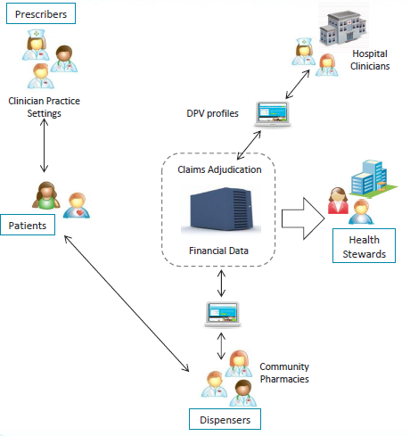
Medication Management-Current Landscape
Pockets of information in each healthcare provider setting
No mechanism to share information and have a complete picture of a patient’s medication profile
Paper-based prescribing which patient’s take into to pharmacies
Notes:
Health Stewards-monitor the activity of the financial and medication information to make sure things are running smoothly and in accordance with the government policies and procedures

Slide 14
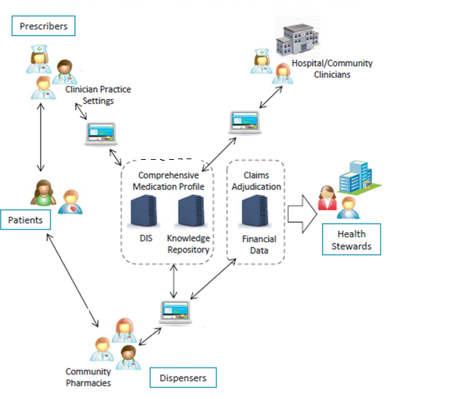
Medication Management- Future Landscape
Clinical
Comprehensive
Collaborative
Notes:
Used by clinicians in their healthcare setting
Used by all healthcare providers who manage medication therapy in the community or at the point of transition
Providing a common information set used in the patient care process therefore supporting interdisciplinary care

Slide 15
Back to the Case….

Slide 16
JP is a 60 year old female who is suffering from a reoccurring rash but is out of her cream and has no refills. Her family physician is on vacation so she decides to go to a local walk-in clinic to see a physician

Slide 17
Comprehensive Medication Profile

Slide 18
In the exam room, the physician creates a new file for JP in the electronic medication record (EMR) as it is her first time at the clinic and records her medical details
JP mentions that she had this rash before and has tried a number of creams but only one has worked
She cannot remember the name of the cream though

Slide 19
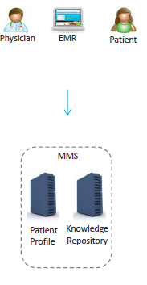
From the EMR, the physician is able to retrieve a patient profile of JP from the MMS that contains:
All prescriptions from her family physician and other walk-in clinics
Everything that has been dispensed for JP
All current allergies
The physician then confirms with JP from her patient profile the cream that has worked best for her in the past
The physician decides to prescribe the same cream

Slide 20
e-Prescribing

Slide 21
The physician uses the EMR to create the eRx and is prompted to include all the necessary information like drug name and instructions
He also includes one refill in case the rash continues before she sees her family physician
The physician asks JP if she would like to “assign” the eRx to a particular pharmacy
JP decides she’d like to pick up her Rx from Shoppers Drug Mart (SDM) close to her home
Notes:
The patient can also keep it unassigned and go to any pharmacy to have it filled

Slide 22
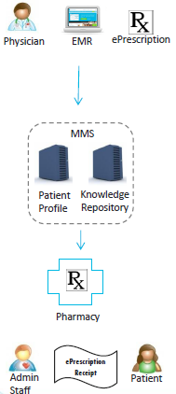
The physician hits send and the eRx is securely sent to the MMS which does a series of checks:
A basic check to make sure the prescription is complete
A check to make sure it does not interact with any allergies or any drug-drug interactions
Before leaving, the admin staff (or physician) prints out a receipt for JP to remind her that she has a prescription at SDM close to her home

Slide 23
Picking up the Rx

Slide 24
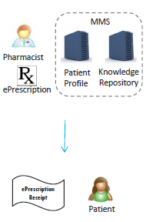
The Pharmacist at SDM receives the eRx in the pharmacy system and then can start dispensing the medication (including making sure there are no drug interactions of allergies etc..)
JP arrives at SDM after her appointment and presents to the pharmacy staff her eRx receipt
Since the prescription was pre-filled, the medication is ready to pick by JP

Slide 25
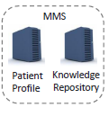
The medication is retrieved and given to JP for which she is counseled on by the Pharmacist
JP leaves the pharmacy with the medication and the Pharmacist records in the MMS that the prescription has been picked up

Slide 26
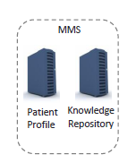
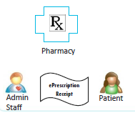
Summary
Step 1
Step 2
Step 3
Step 4
Step 7
Step 6
Step 5
Notes:
1.

Slide 27
Other Functionalities within the MMS
Send renewal requests to Prescribers
Quicker more efficient communication with other health care professionals (Online Portal)
Pharmacy System will be able to create eRx’s as well
Documentation/Clinical Notes will available to all health care professionals

Slide 28
Benefits for Patients
Fewer medication errors because electronic prescriptions will be legible and complete
Improved access for patients:
Patients will not have to wait for days while pharmacies clarify incomplete prescriptions (Continuity of care)
“Assigned” prescriptions will be ready for patients to pick up when they arrived (Better services with prescriptions)

Slide 29
Benefit for Pharmacists
The pharmacy will be able to prefill “assigned” prescriptions before the patient arrives to pick up the medications allowing more time for clinical services and clinics
Much fewer adverse drug reactions
Having access to a complete and up-to-date medication history, regardless of location, which means patients will receive more informed care
Increased collaboration among health care professionals

Slide 30
Future Outlooks
EMR Adopter Project (March 2014)
First Phase :
Integration of MMS into community pharmacies
Second Phase:
Integration with Hospitals
Integration with OLIS
End Goal: Regional Integration (AKA Electronic Health Records (EHRs) for all Ontarians)
Notes:
-The New EMR Adopter Funding Program (NA) assists physicians in their transition from paper-based records to electronic medical records Runs till March 2014

Slide 31
My website
http://ehealthontariomms.weebly.com
Notes:
Cases, ePrescribing pilot project and useful links to the more detail on the current initiatives at eHealth Ontario

Slide 32
References
Personal ties exposed in eHealth's untendered contracts - Canada - CBC News. Available at: http://www.cbc.ca/news/canada/story/2009/06/02/ehealth-ontario-contracts.html. Accessed: Jun 11th,2013.
Head of eHealth Ontario is fired amid contracts scandal, gets big package - Canada - CBC News. Available at: http://www.cbc.ca/news/canada/story/2009/06/07/ehealth-kramer.html. Accessed: June 11th, 2013
EHealth scandal a $1B waste: auditor - Toronto - CBC News. Available at: http://www.cbc.ca/news/canada/toronto/story/2009/10/07/ehealth-auditor.html. Accessed: June 11th, 2013.
Canada’s First ePrescribing Program Launches in Ontario - eHealth Ontario. Available at: http://www.ehealthontario.on.ca/en/news/view/canadas-first-eprescribing-program-launches-in-ontario. Accessed: June 11th, 2013.
Online patient records enhancing care for 2 million Ontarians - eHealth Ontario. Available at: http://www.ehealthontario.on.ca/en/news/view/online-patient-records-enhancing-care-for-2-million-ontarians. Accessed: June 11th, 2013.
Diagnostic Imaging Repositories: Provincial strategy | Hospital News. Available at: http://www.hospitalnews.com/diagnostic-imaging-repositories-provincial-strategy-begins-with-regional-successes/. Accessed: June 11th, 2013.
Initiatives - eHealth Ontario. Available at: http://www.ehealthontario.on.ca/en/initiatives. Accessed: June 11th, 2013.
Medication Management System - eHealth Ontario. Available at: http://www.ehealthontario.on.ca/en/initiatives/view/medication-management-system Accessed: June 11th, 2013.
eHealth Ontario. “Overview of MMS”. eHealth Ontario, Toronto. June 7th, 2013. Internal presentation
Image Reference: Electronic Prescriptions: Is Medicare Slapping You With An E-Prescribing Penalty? Available at: http://electronichealthrecordrescue.com/health-care-news/electronic-prescriptions-is-medicare-slapping-you-with-an-e-prescribing-penalty/. Accessed: June 11th, 2013.
Image Reference: Bronx NY Defective Medications Lawyers NYC Attorneys Brooklyn Lawyer Attorney Law Firm Firms New York City. Available at: http://www.accidentlegalhelp.com/defective-medications.html. Accessed: June 11th, 2013.
Question Mark - Xconomy.Available at: http://www.xconomy.com/san-francisco/2011/11/16/why-do-people-answer-questions-on-qa-sites-ask-com-users-speak-up/attachment/a/ . Accessed: June 12th, 2013.

Slide 33
Questions

